Slide 1
HOME ALARM SYSTEM
Flavio Baccarini
16/01/2023 Electronics for Applied Physics

Slide 2
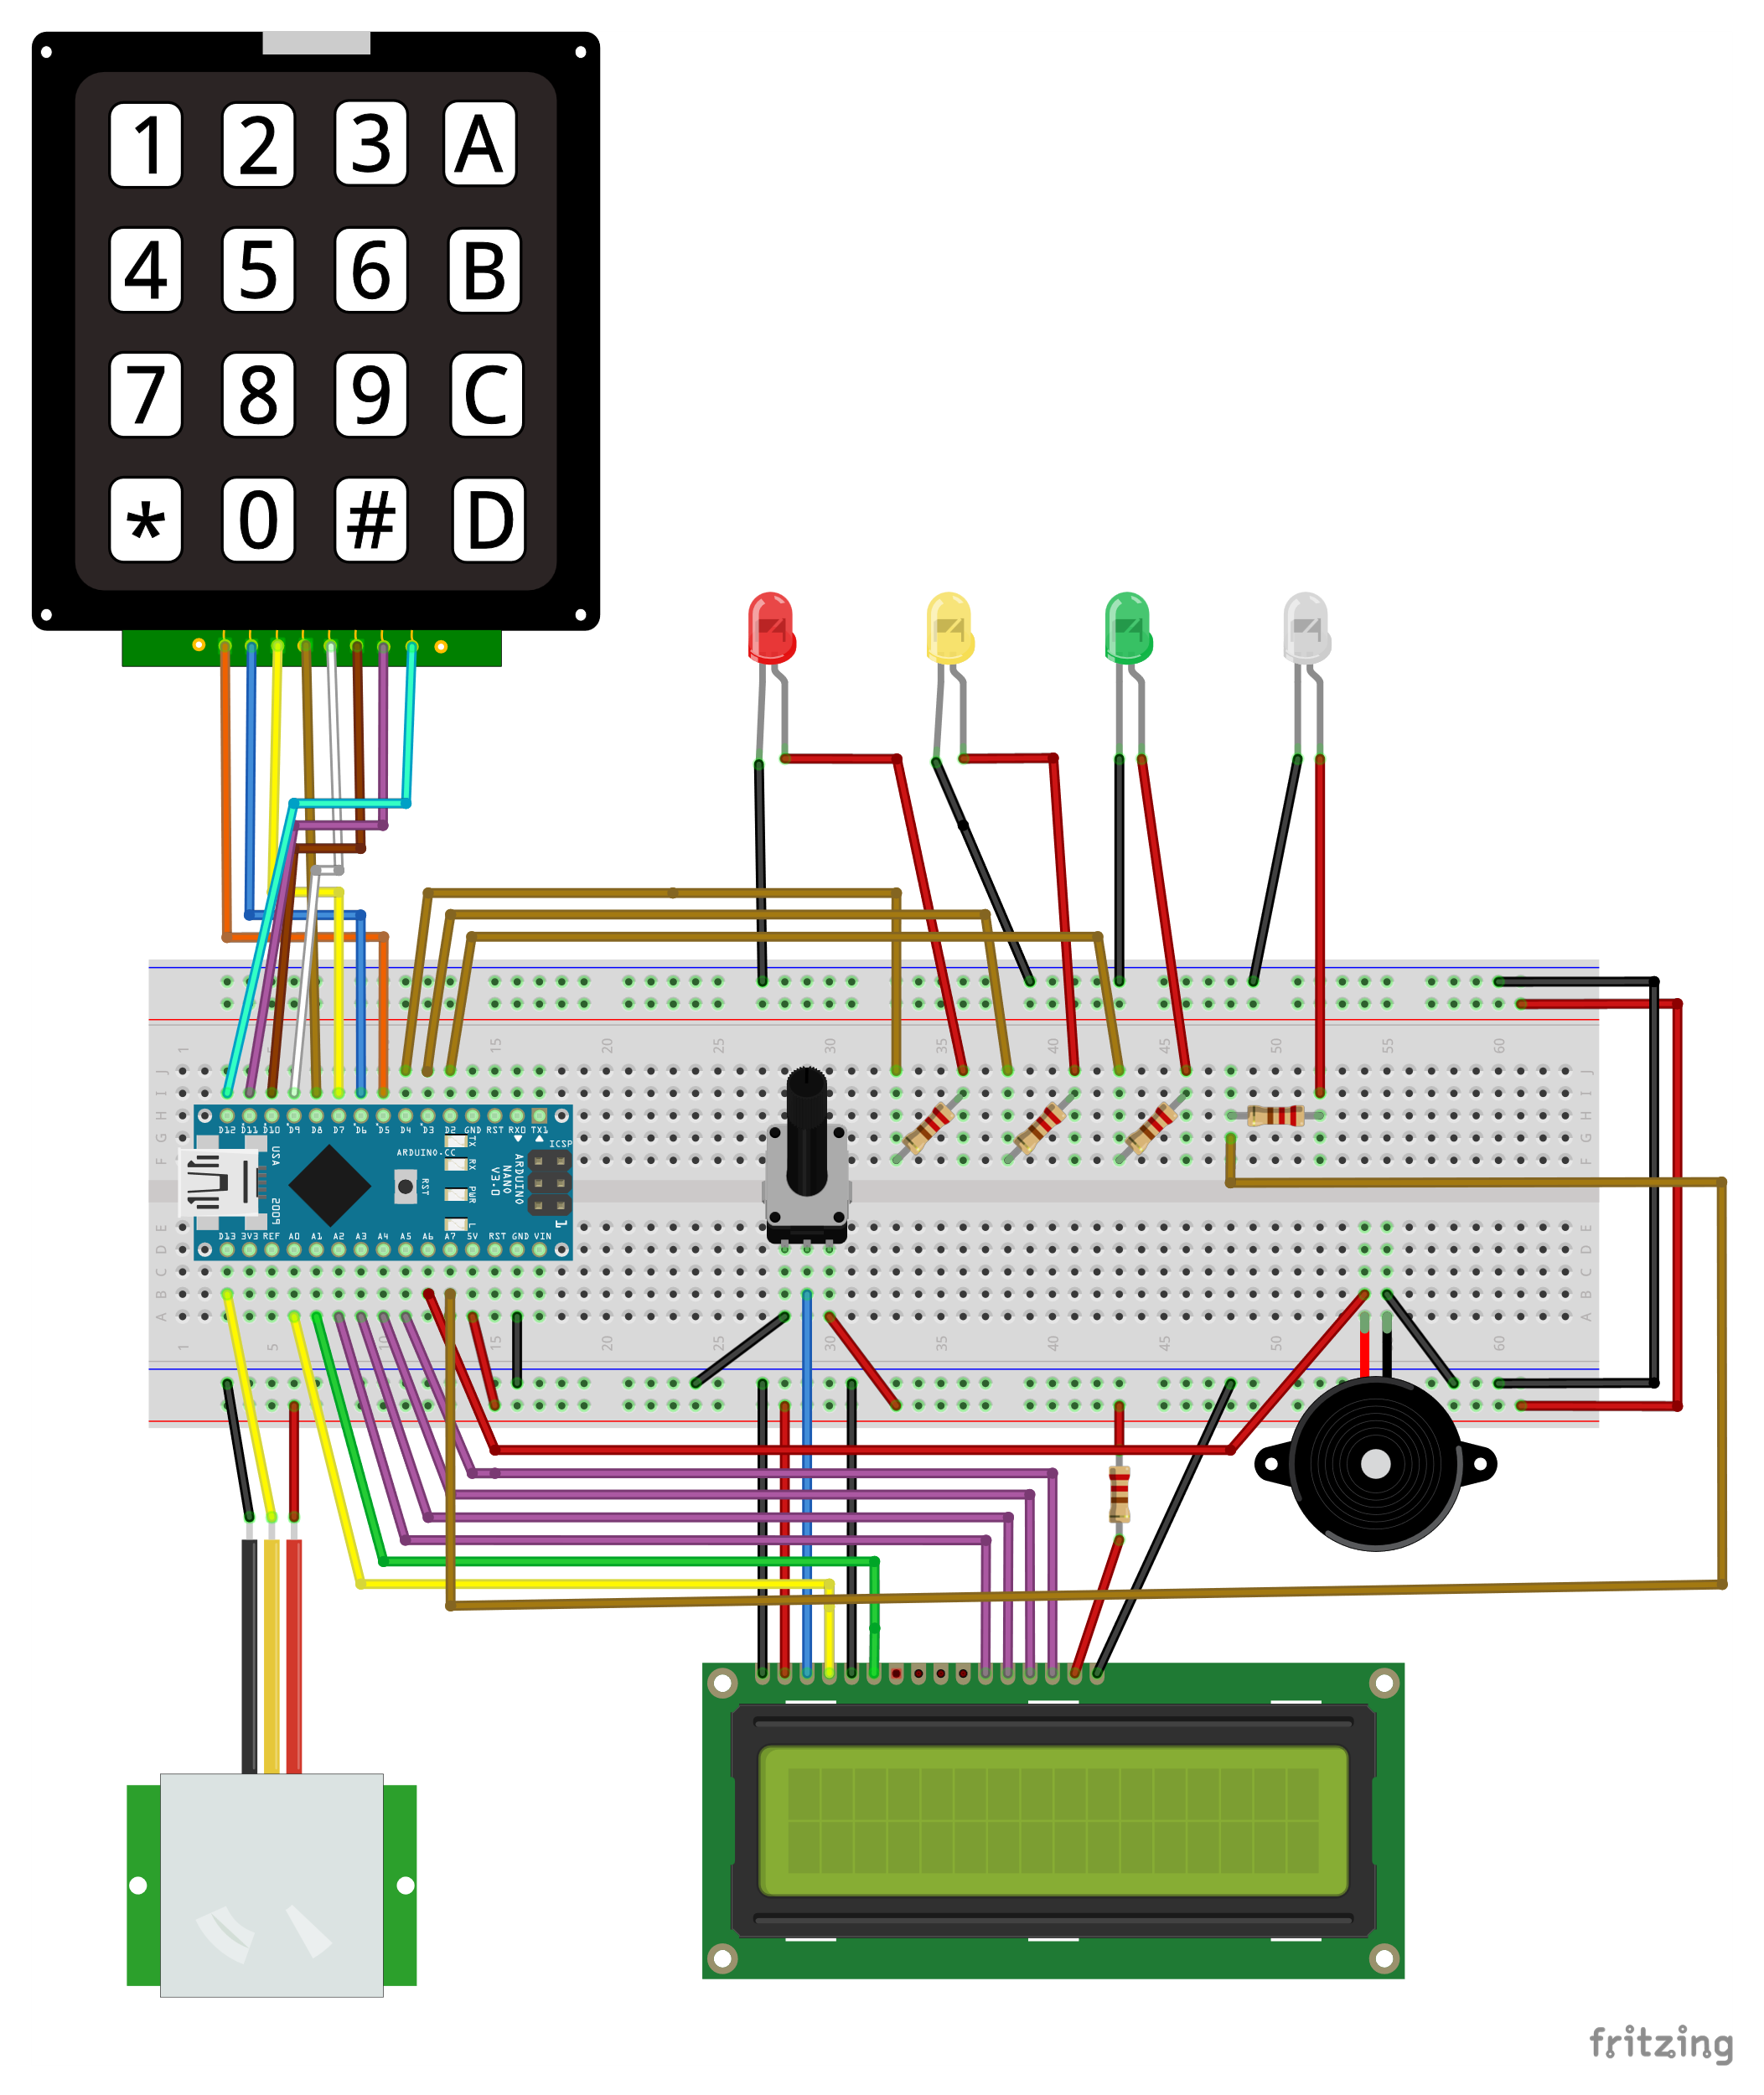
SCHEMATICS
KEYPAD FOR PASSWORD
WAIT FOR PASSWORD
WIFI CONNECTION
WRONG
PASSWORD
CORRECT
PASSWORD
ARDUINO NANO 33 IOT
(WITH WIFI MODULE)
10kΩ POTENTIOMETER FOR DISPLAY CONTRAST
PIEZO
SPEAKER (PASSIVE BUZZER)
PIR SENSOR
LCD DISPLAY (16x2)
2

Slide 3
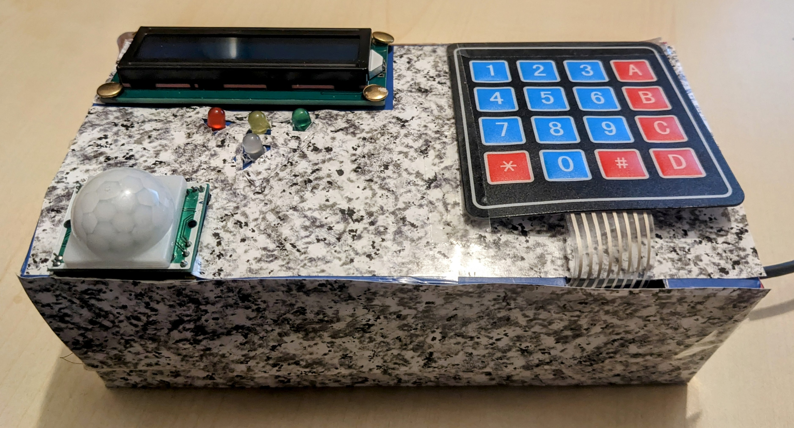
THE OVERALL SYSTEM
3

Slide 4

PASSIVE INFRARED SENSOR
PIR -> light radiation (infrared radiation).
Passive because PIR don’t radiate energy.
PIR only detect the radiation emitted or reflected from objects.
All objects (with T > 0 K) emit heat energy in the form of EM radiation. This radiation usually is not visible to the human eye (infrared radiation).
4
Notes:
A passive infrared sensor (PIR sensor) is an electronic sensor that measures infrared (IR) light radiating from objects in its field of view.
The term passive refers to the fact that PIR devices do not radiate energy for detection purposes. They work entirely by detecting infrared radiation (radiant heat) emitted by or reflected from objects.
All objects with a temperature above absolute zero emit heat energy in the form of electromagnetic radiation. Usually this radiation isn't visible to the human eye because it radiates at infrared wavelengths, but it can be detected by electronic devices designed for such a purpose.
A PIR sensor can detect changes in the amount of infrared radiation impinging upon it, which varies depending on the temperature and surface characteristics of the objects in front of the sensor. When an object, such as a person, passes in front of the background, such as a wall, the temperature at that point in the sensor's field of view will rise from room temperature to body temperature, and then back again. The sensor converts the resulting change in the incoming infrared radiation into a change in the output voltage, and this triggers the detection. Objects of similar temperature but different surface characteristics may also have a different infrared emission pattern, and thus moving them with respect to the background may trigger the detector as well.
The module also consists a specially designed cover named Fresnel lens, which focuses the infrared signals onto the pyroelectric sensor.
The PIR sensor itself has two slots in it, each slot is made of a special material that is sensitive to IR.
When the sensor is idle, both slots detect the same amount of IR, the ambient amount radiated from the room or walls or outdoors. When a warm body like a human or animal passes by, it first intercepts one half of the PIR sensor, which causes a positive differential change between the two halves. When the warm body leaves the sensing area, the reverse happens, whereby the sensor generates a negative differential change. These change pulses are what is detected.
A piezoelectric speaker (also known as a piezo bender due to its mode of operation, and sometimes colloquially called a "piezo", buzzer, crystal loudspeaker or beep speaker) is a loudspeaker that uses the piezoelectric effect for generating sound. The initial mechanical motion is created by applying a voltage to a piezoelectric material, and this motion is typically converted into audible sound using diaphragms and resonators.

Slide 5
FINITE STATE MACHINE (FSM)
Finite number of states.
One state at any given time.
FSM can change from one state to another in response of some inputs. This change is called transition.
The FSM is defined by its states and the inputs for the transition.
5
Notes:
A finite-state machine (FSM) is a mathematical model of computation. It is an abstract machine that can be in exactly one of a finite number of states at any given time. The FSM can change from one state to another in response to some inputs; the change from one state to another is called a transition. An FSM is defined by a list of its states, its initial state, and the inputs that trigger each transition

Slide 6
ALL THE STATES OF THE SYSTEM
OFFLINE -> INITIAL STATE
WAITING -> HANDLE THE PASSAGE FROM DIFFERENT STATES
PIR ACTIVATED -> THE PIR SENSOR IS ACTIVATED
BUZZER ACTIVATED -> THE BUZZER SPEAKER IS ACTIVATED
INCORRECT -> THE USER TYPES WRONGLY THE PASSWORD
6

Slide 7
ALL THE TRANSITIONS BETWEEN STATES
OFFLINE -> WAITING -> PIR ACTIVATED
OFFLINE -> INCORRECT -> OFFLINE
PIR ACTIVATED -> BUZZER ACTIVATED
BUZZER ACTIVATED -> WAITING -> OFFLINE
BUZZER ACTIVATED -> INCORRECT -> BUZZER ACTIVATED
7

Slide 8
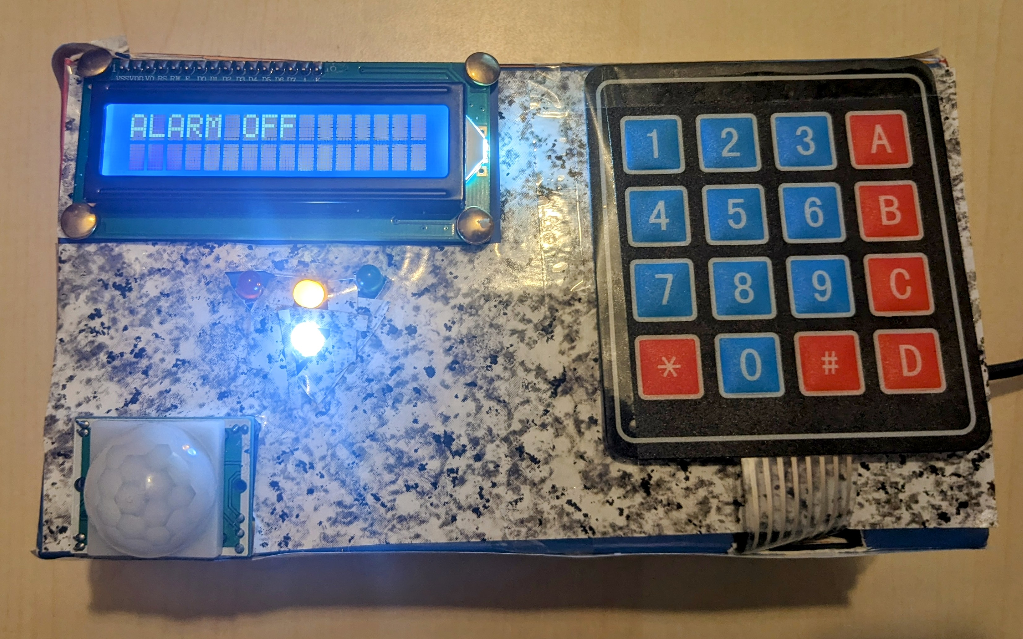
INITIAL STATE
8

Slide 9
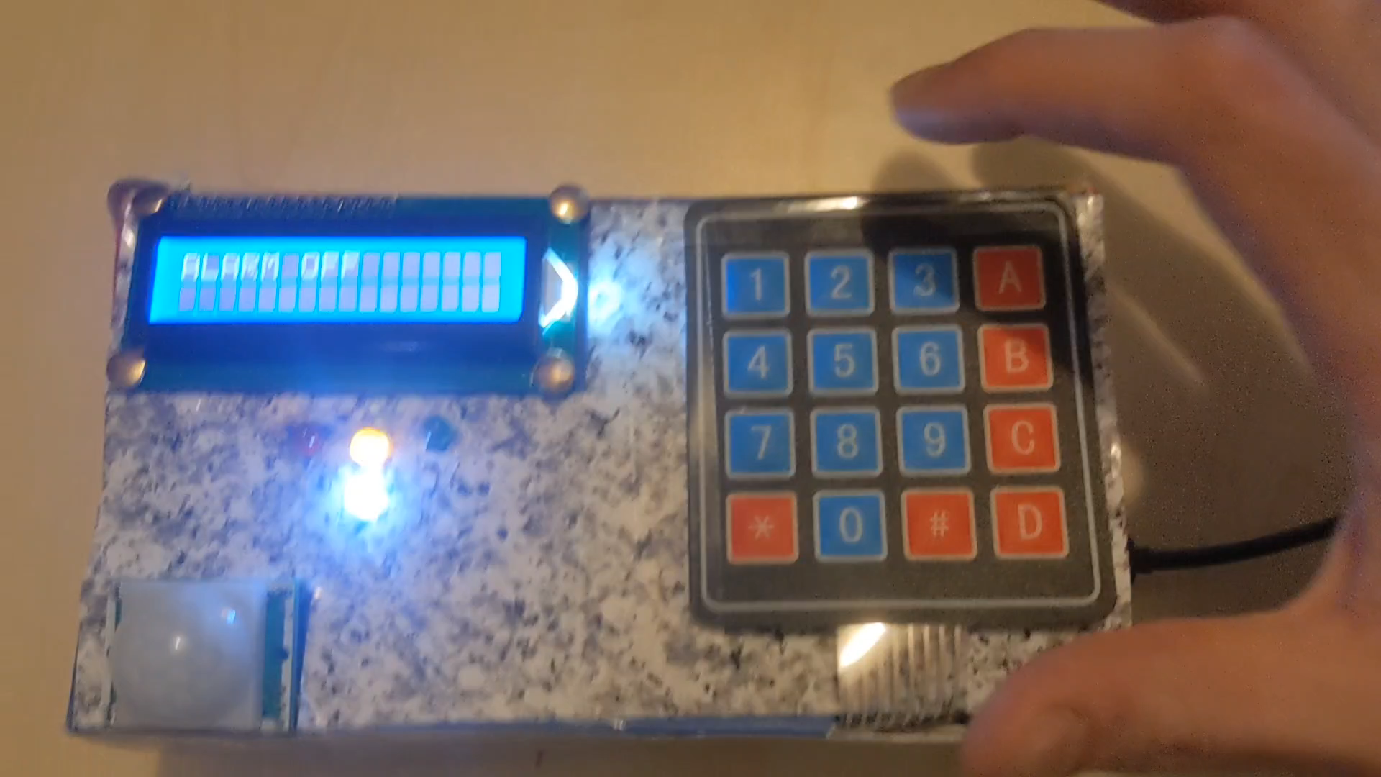
OFFLINE -> WAITING -> PIR ACTIVATED
Initial state: OFFLINE.
The correct password is: 1234* (the * is to conferm the pin).
The user types the correct PIN.
Waiting some seconds (the user exits from home).
Final state: PIR ACTIVATED.
From now it will detect movements.
9

Slide 10
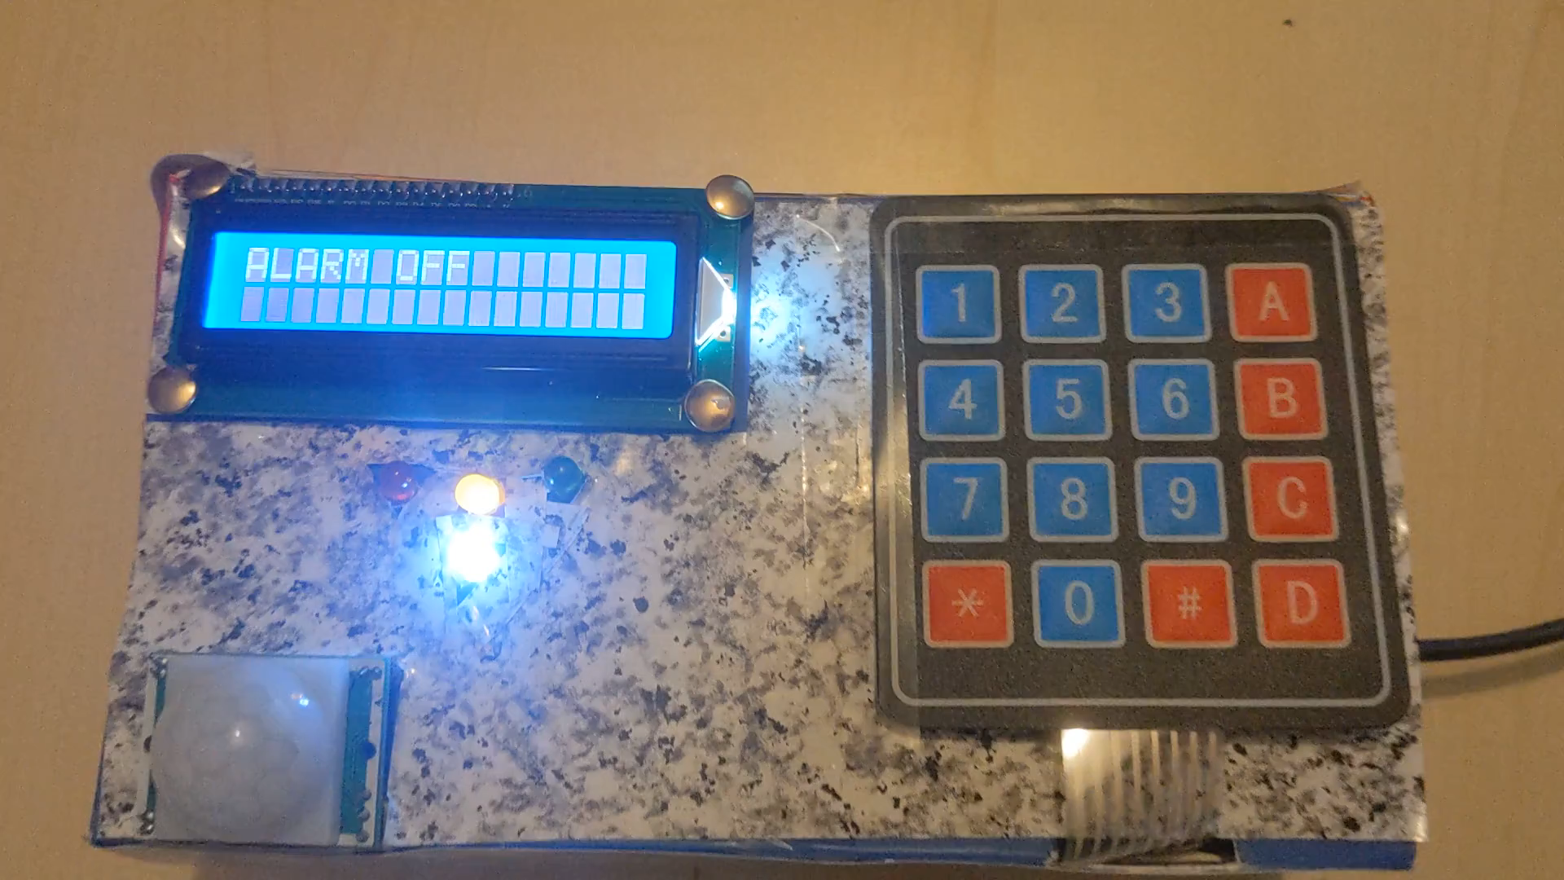
OFFLINE -> INCORRECT -> OFFLINE
Initial state: OFFLINE.
The correct password is: 1234* (the * is to conferm the pin).
The user types the wrong PIN.
Final state: OFFLINE with an error message on LCD display.
10

Slide 11
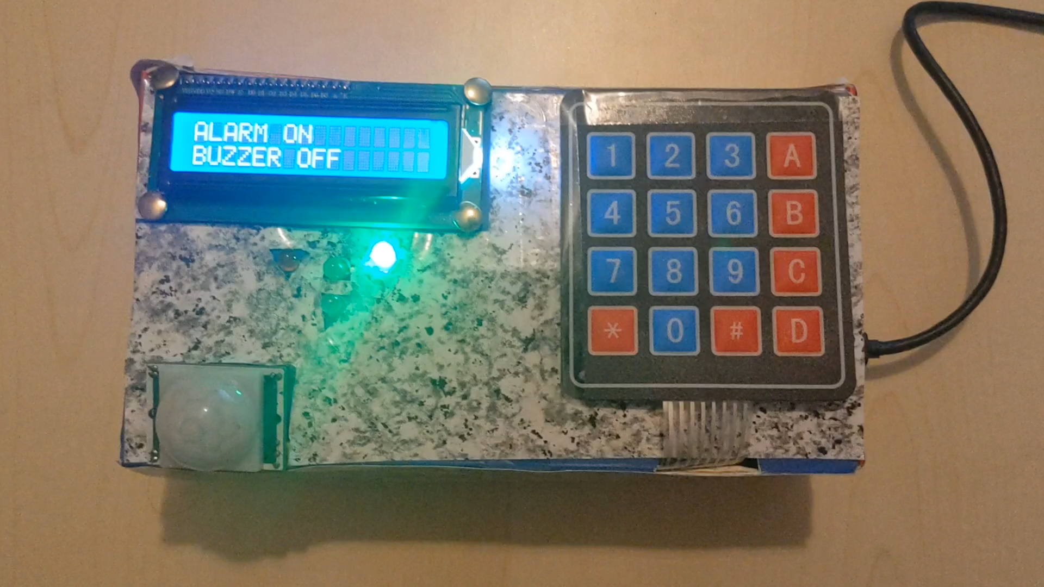
PIR ACTIVATED -> BUZZER ACTIVATED
Initial state: PIR ACTIVATED.
When PIR sensor sees some movements there is the transition to BUZZER ACTIVATED state.
Final state: BUZZER ACTIVATED with the speaker that turns on.
11

Slide 12
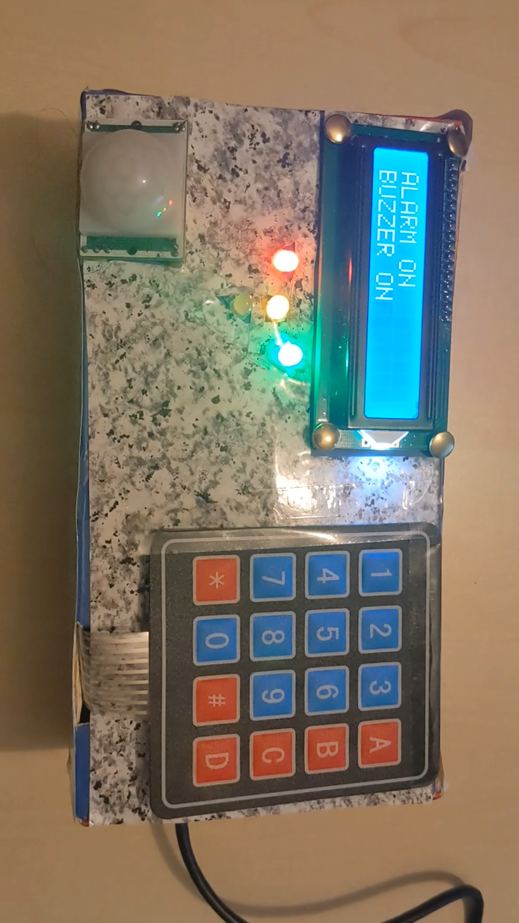
BUZZER ACTIVATED -> WAITING -> OFFLINE
Initial state: BUZZER ACTIVATED.
The correct password is: 1234* (the * is to conferm the pin).
If the buzzer is ON and the user types the correct password the system goes OFFLINE with some waiting time.
Final state: OFFLINE.
12

Slide 13
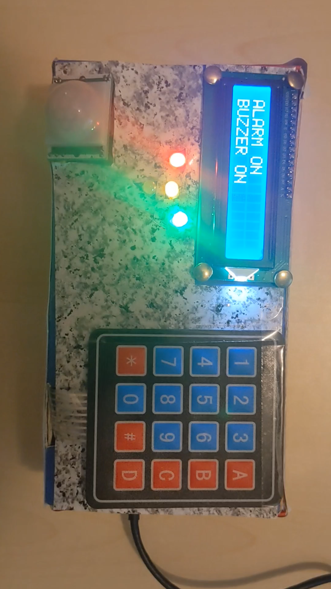
BUZZER ACTIVATED -> INCORRECT -> BUZZER ACTIVATED
Initial state: BUZZER ACTIVATED.
The correct password is: 1234* (the * is to conferm the pin).
If the buzzer is ON and the user types the wrong password the system stays in the BUZZER ACTIVATED state.
Final state: BUZZER ACTIVATED with an error message on LCD display.
13

Slide 14
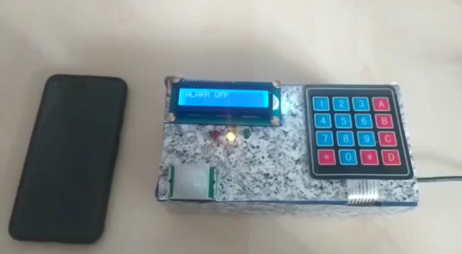
WEBHOOKS AND IFTTT
Arduino Nano 33 IOT Wi-Fi connectivity: Nina W102 uBlox module.
Arduino can send a phone call when the PIR sensor is HIGH. Arduino send a POST HTTP request to Webhooks and, thanks to the integration with IFTTT it sends a phone call to the smartphone.
14

Slide 15
THANKS FOR THE ATTENTION

Slide 16
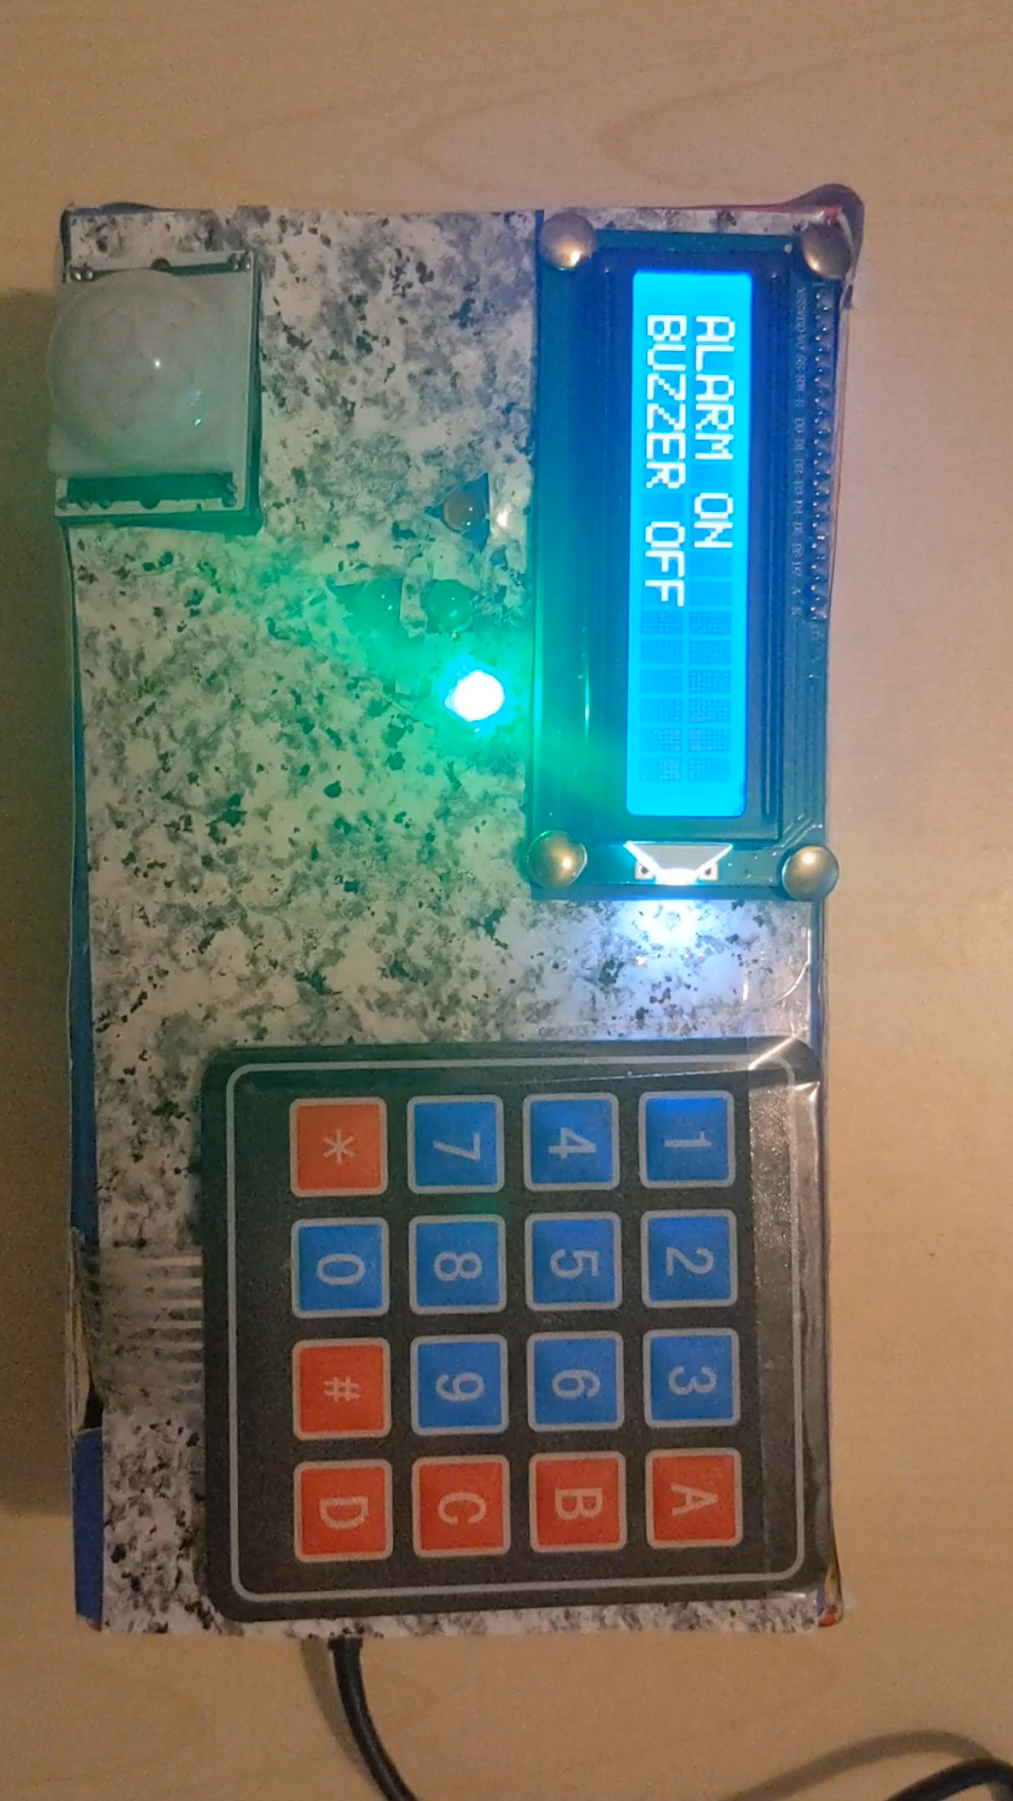
PIR ACTIVATED -> WAITING -> OFFLINE
Initial state: PIR ACTIVATED.
The correct password is: 1234* (the * is to conferm the pin).
If the PIR sensor sees no movement and the user types the correct password the system goes offline.
Final state: OFFLINE.
16

Slide 17
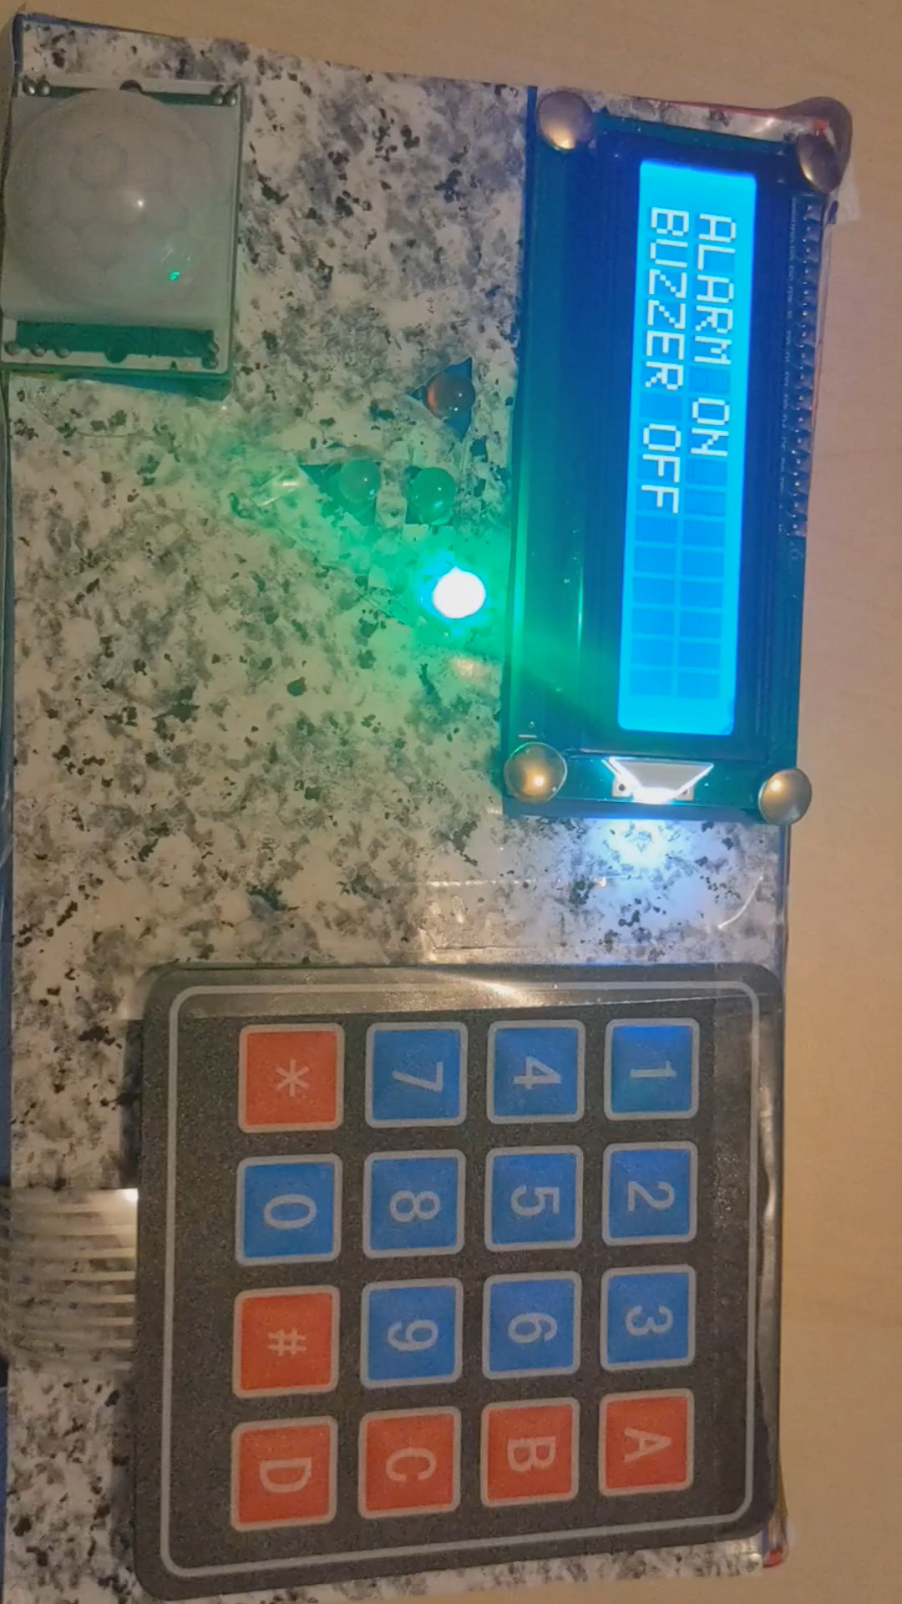
PIR ACTIVATED -> INCORRECT -> PIR ACTIVATED
Initial state: PIR ACTIVATED.
The correct password is: 1234* (the * is to conferm the pin).
If the PIR sensor sees no movement and the user types the wrong password the system stays in PIR ACTIVATED state with an error message displayed.
Final state: PIR ACTIVATED.
17

